Slide 1
Capstone Project
Paige Leon & Cooper Graves

Slide 2
Overview
Web-based fiduciary accounting software
Used to create well formatted reports
Makes accounting simple for conservators
Removes the cluttered aspects of other similar software
Minimal server setup for users

Slide 3
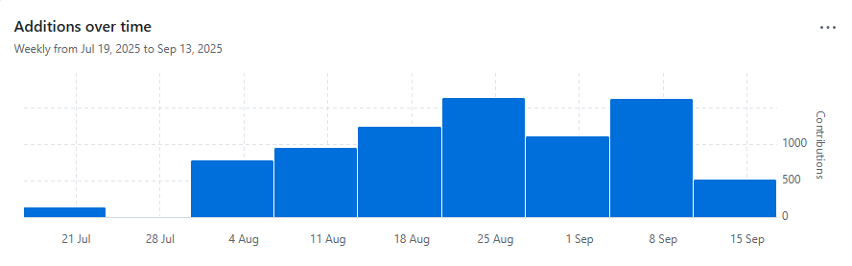
Timeline
Week 1 – Brainstorming
Week 2 & 3 – Planning and design
Week 4 – Begin Coding
Week 8 – Crunch begins
Present – Capstone finished!
Week 11 and on – To be seen in the future

Slide 4
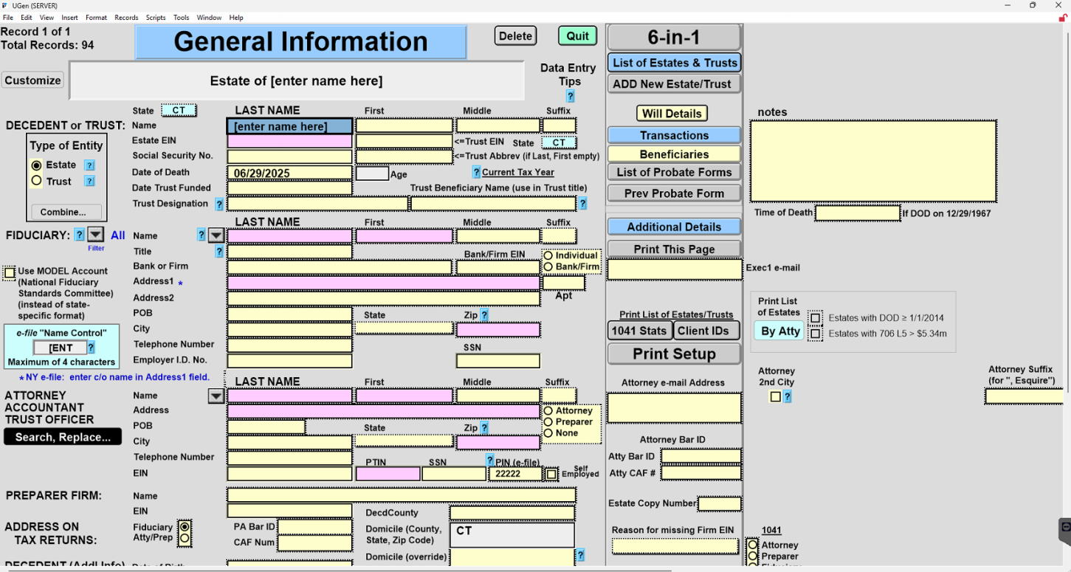
Design Basis

Slide 5
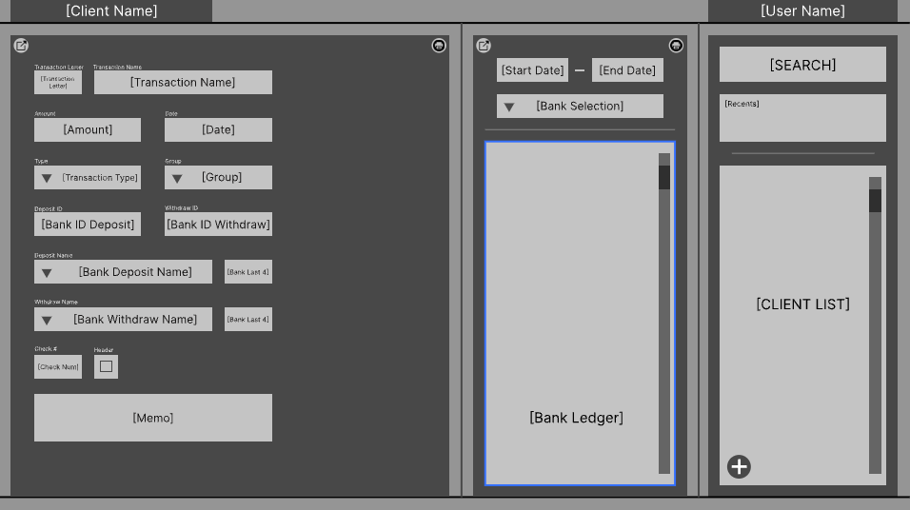
The Initial Design

Slide 6
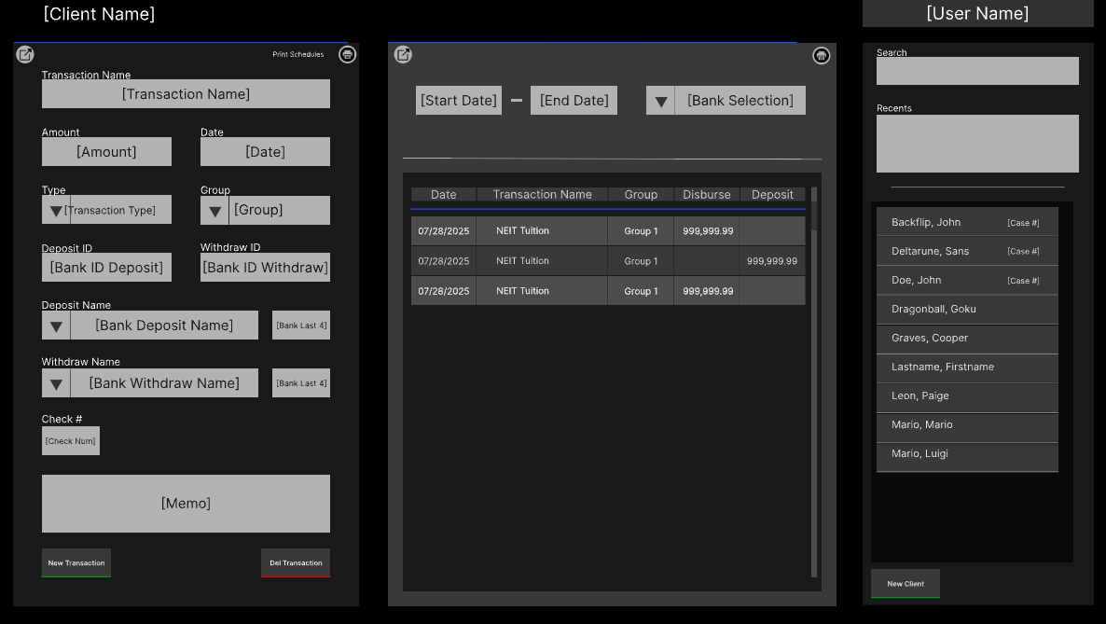
Revision One

Slide 7
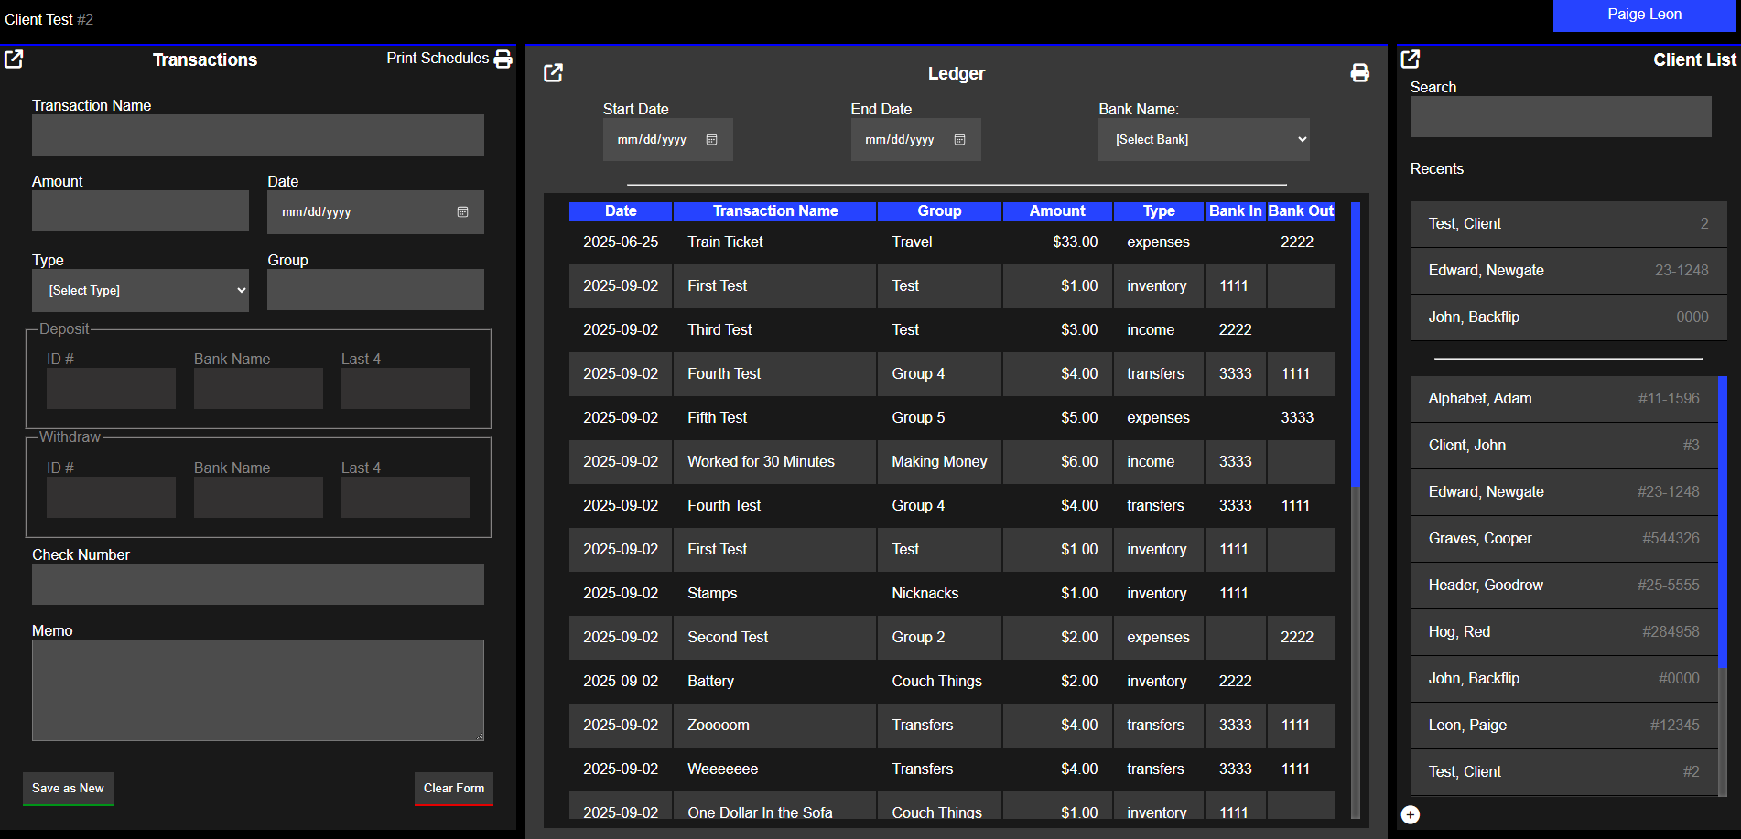
Final Design

Slide 8
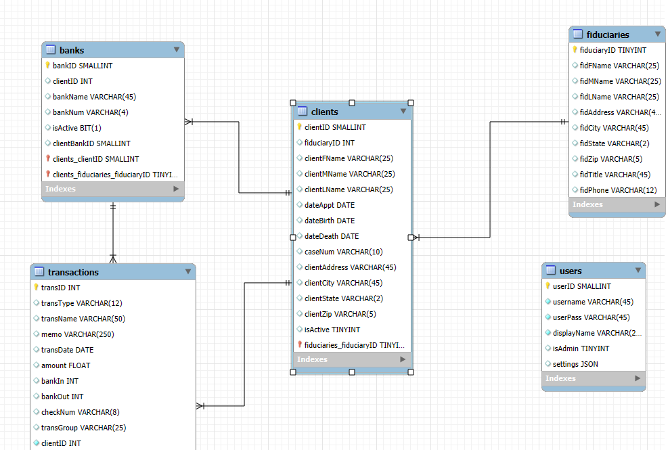
ERD

Slide 9
Technical Design
Compartmentalized file structure
Style sheets and functions based on includes
Used variables for standardized colors
Decided naming conventions early on
Strong initial database design

Slide 10
Obstacles Overcame
Schedule mismatches
Communication of concepts
Over relying on post methods
Not used to MySQL syntax
Shutdown and logout functionality
Maintaining code organization

Slide 11
UI Design Lessons
Paige's Takeaways
Less is more
Feedback is important even when you disagree
Little things can make a huge difference
Coopers's Takeaways
Dark themes work best for programs with prolonged use
A few colors is more than enough
Updating your prototype based on feedback

Slide 12
In Summary
Planned and designed
Programmed and tested
Received feedback and improved
We're not done yet

